Slide 1
Data Stuctures and Algorithms
Dr. Fidaa Abed

Slide 2
Using ArrayBasedList as a Queue
add(x) → add(x,n) O(1) ☺
remove() → remove(0) O(n) ☹
Can We Have Both as O(1) ????

Slide 3
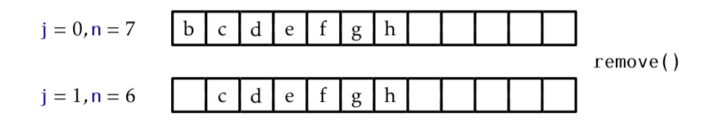
Circular Implementation

Slide 4
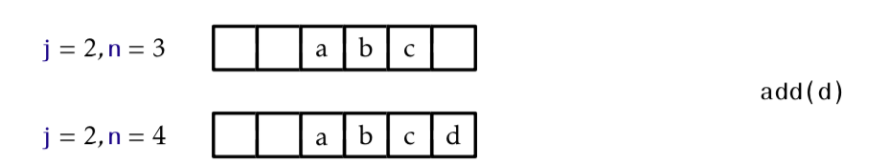
Circular Implementation

Slide 5
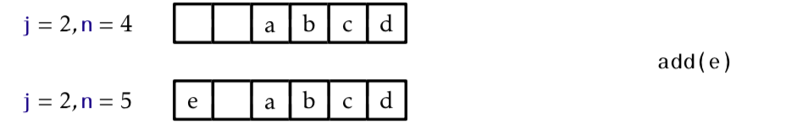
Circular Implementation
a[ j+n % a.length] = ”e”

Slide 6
ArrayBasedQueue
add(x)
Will add element x at the end of the queue
remove()
Will remove the element at the beginning of the queue

Slide 7
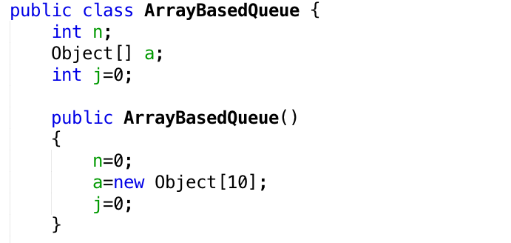
ArrayBasedQueue

Slide 8
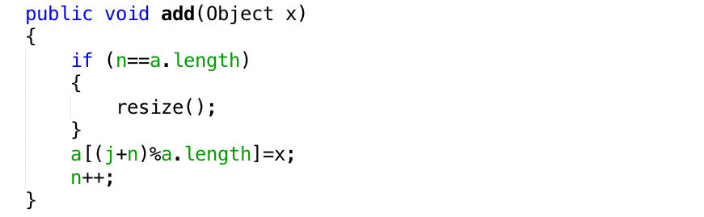
add(x)
O(1)

Slide 9
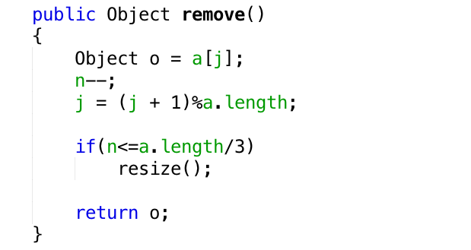
remove()
O(1)

Slide 10
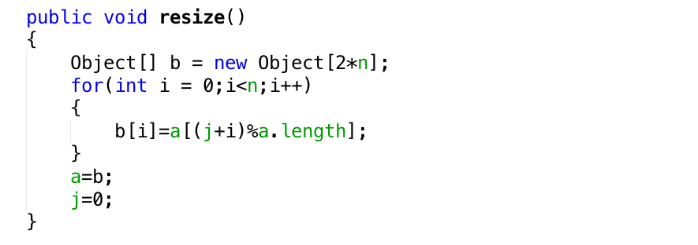
resize()
O(n)

Slide 11
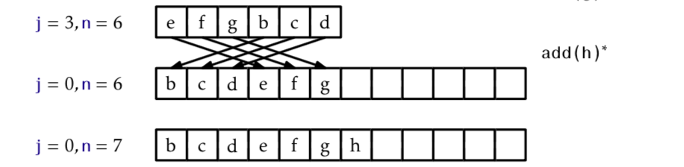
resize()

Slide 12
Excercise

